Slide 1
Lecture 28

Slide 3
Question 123.11.1
You open your freezer (or a door in January in Rexburg), does energy flow out, or does cold flow in?
Cold in
Energy out

Slide 4
Question 123.11.2
You use Joule’s paddle apparatus to raise the temperature of a fluid. Is any heat involved?
Yes
No
Maybe

Slide 5
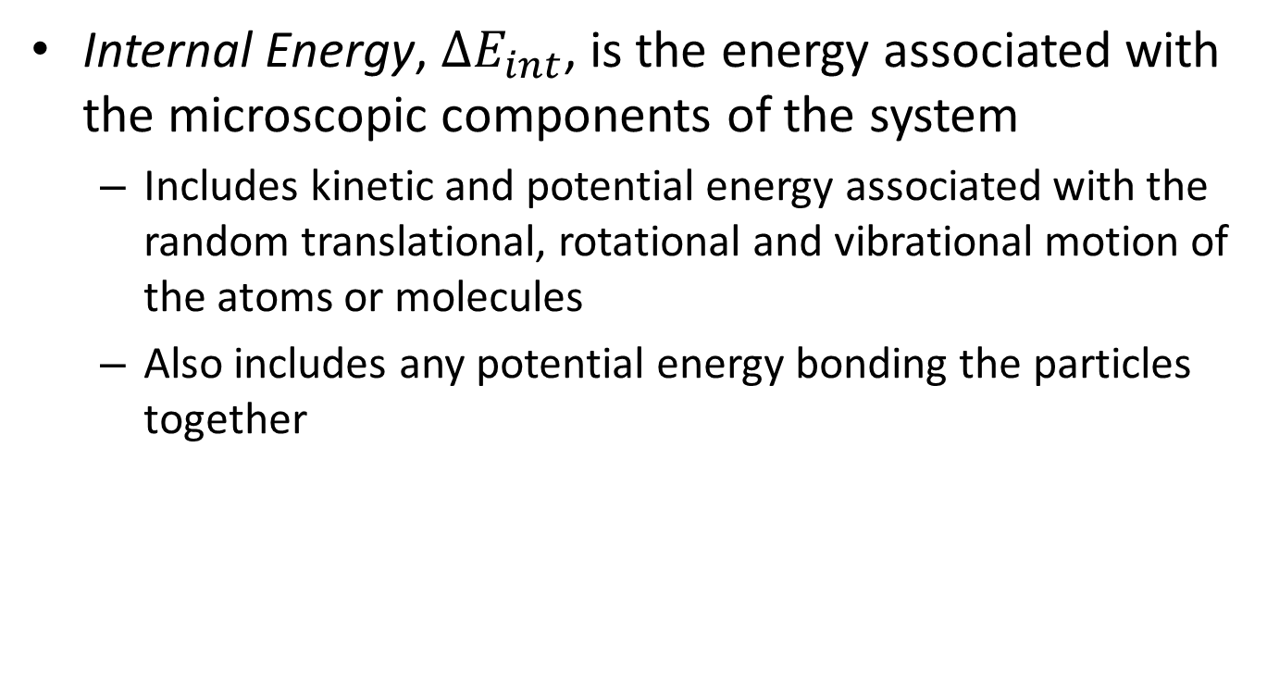
Internal Energy
Internal Energy, $∆E_{int}$, is the energy associated with the microscopic components of the system
Includes kinetic and potential energy associated with the random translational, rotational and vibrational motion of the atoms or molecules
Also includes any potential energy bonding the particles together
internal energy is all the energy of a system that is associated with its microscopic components -- atoms and molecules -- when viewed form a reference frame at rest with respect to the center of mass of the system.

Slide 6


Review Center of Mass
Recall that
Where
For a group of molecules

Slide 7
Energy Transfer
When two objects of different temperatures are placed in thermal contact, the temperature of the warmer decreases and the temperature of the cooler increases
The energy exchange ceases when the objects reach thermal equilibrium
The concept of energy was broadened from just mechanical to include internal
Made Conservation of Energy a universal law of nature

Slide 8
Heat Compared to Internal Energy
Important to distinguish between them
They are not interchangeable
They mean very different things when used in physics

Slide 9
Heat
Heat is the transfer of energy between a system and its environment because of a temperature difference between them
The symbol Q is used to represent the amount of energy transferred by heat between a system and its environment

Slide 10
Units of Heat
Calorie
An historical unit, before the connection between thermodynamics and mechanics was recognized
A calorie is the amount of energy necessary to raise the temperature of 1 g of water from 14.5° C to 15.5° C .
A Calorie (food calorie) is 1000 cal

Slide 11
Units of Heat, cont.
US Customary Unit – BTU
BTU stands for British Thermal Unit
A BTU is the amount of energy necessary to raise the temperature of 1 lb of water from 63° F to 64° F
1 cal = 4.186 J
This is called the Mechanical Equivalent of Heat

Slide 12
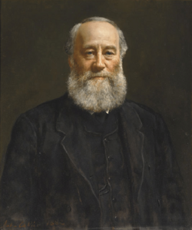
James Prescott Joule
1818 – 1889
British physicist
Conservation of Energy
Relationship between heat and other forms of energy transfer

Slide 13
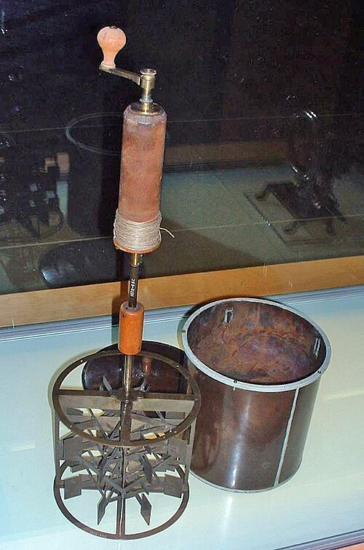
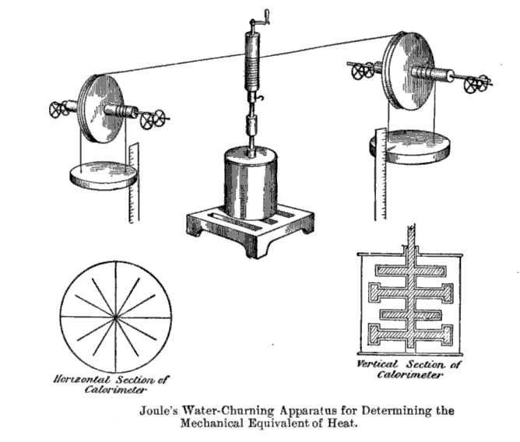

Slide 14



Slide 15
ΔT
Q

Slide 17
Specific Heat
Every substance requires a unique amount of energy per unit mass to change the temperature of that substance by 1° C
The specific heat, c, of a substance is a measure of this amount

Slide 18
Specific Heat
Every substance requires a unique amount of energy per unit mass to change the temperature of that substance by 1° C
The specific heat, c, of a substance is a measure of this amount

Slide 20
Units of Specific Heat
SI units
J / kg °C
Historical units
cal / g °C

Slide 21
Heat and Specific Heat
Q = m c ΔT
ΔT is always the final temperature minus the initial temperature
When the temperature increases, ΔT and ΔQ are considered to be positive and energy flows into the system
When the temperature decreases, ΔT and ΔQ are considered to be negative and energy flows out of the system

Slide 22

A Consequence of Different Specific Heats
Water has a high specific heat compared to land
On a hot day, the air above the land warms faster
The warmer air flows upward and cooler air moves toward the beach

Slide 23
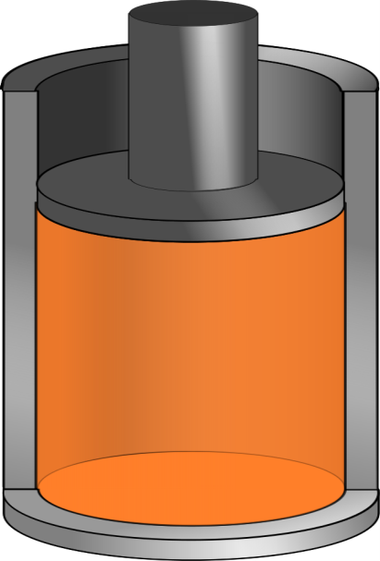
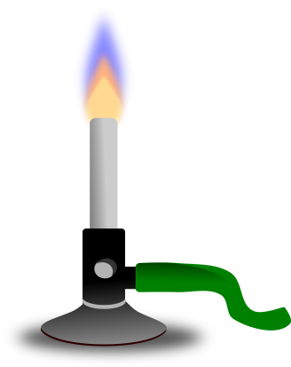
Q negative
Q positive

Slide 24
Question 123.12.2
You add energy to an object by heat transfer. At some point, the temperature of the object stops rising. What is happening?
The system is leaking thermal energy
The system has as much heat as it can take
The object is experiencing a phase change
Can’t tell

Slide 26
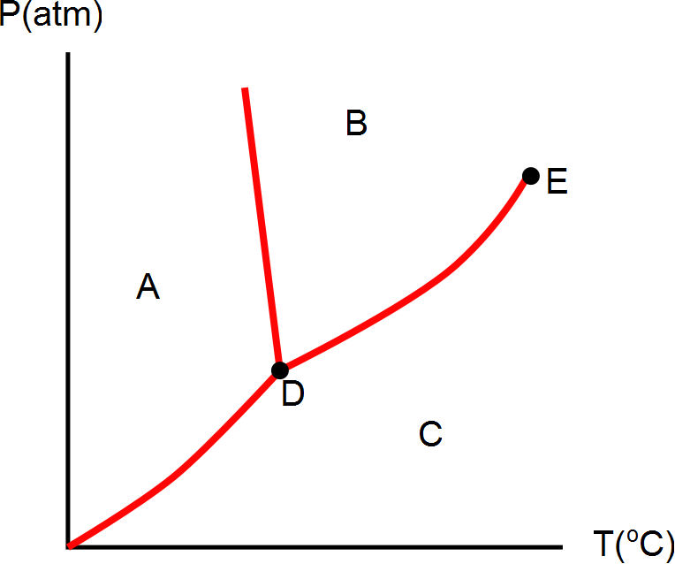
Question 123.8.11
What phase would this substance have if is were in the state represented by letter C?
Solid
Liquid
Gas
Plasma

Slide 29
Question 123.8.11
What phase would this substance have if is were in the state represented by letter A?
Solid
Liquid
Gas
Plasma

Slide 30
Question 123.8.11
What phase would this substance have if is were in the state represented by letter B?
Solid
Liquid
Gas
Plasma

Slide 31
Question 123.8.12
What is point D?
Sublimation point
Boiling point
Triple point
Double point
Critical point

Slide 32
Question 123.8.12
What is point E?
Sublimation point
Boiling point
Triple point
Double point
Critical point

Slide 33
Question 123.8.12
What do we call moving from region A to region B?
Boiling
Freezing
Melting
Condensing
Sublimation

Slide 34
Question 123.8.12
What do we call moving from region A to region C?
Boiling
Frezzing
Melting
Condensing
Sublimation

Slide 35
Question 123.8.12
What do we call moving from region B to region C?
Boiling
Frezzing
Melting
Condensing
Sublimation

Slide 36
Question 123.8.12
What do we call moving from region C to region B?
Boiling
Frezzing
Melting
Condensing
Sublimation

Slide 37
Question 123.8.12
What do we call moving from region B to region A?
Boiling
Frezzing
Melting
Condensing
Sublimation

Slide 38
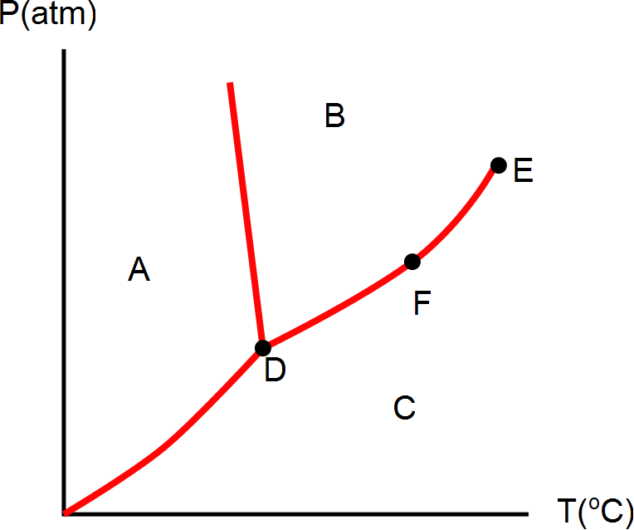
Question 123.8.12
What phase is the material at if it is in the state represented by letter D?
Solid
Liquid
Gas
Plasma
Can’t tell

Slide 39
Question 123.8.12
What can we say about the state represented by point F?
Solid
Liquid
Gas
Plasma
It is a phase equilibrium

Slide 40
[Figure] [More Complete Phase Diagram for Water (Public Domain Image courtesy Karlhahn)]

Slide 41
Question 123.12.1.1
I have a sample of a substance with a heat capacity of 100J/K. How much heat can this sample hold if it is at 2000K?
2000000J
20J
0.5J
None at all

Slide 42
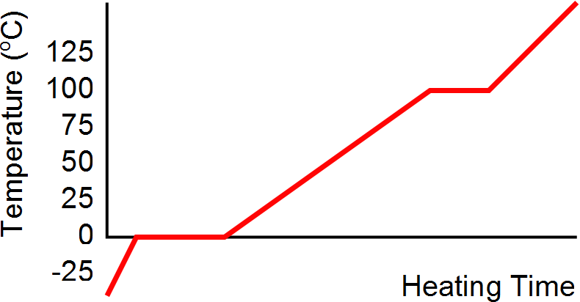
Heating Ice
Gaseous steam
Boiling water
Liquid water
Melting ice
Solid ice

Slide 43
Graph of Ice to Steam
T(ºC)
150
120
90
60
30
0
-30
Steam
Water and Steam
Water
Ice and water
0 500 1000 1500 2000 2500 3000
Ice
Energy added (J)

Slide 44
Calorimeter
One technique for determining the specific heat of a substance
A calorimeter is a vessel that is a good insulator which allows a thermal equilibrium to be achieved between substances without any energy loss to the environment

Slide 45
Calorimetry
Analysis performed using a calorimeter
Conservation of energy applies to the isolated system
The energy that leaves the warmer substance equals the energy that enters the water
Q_{cold} = -Q_{hot}
Negative sign keeps consistency in the sign convention of ΔT

Slide 46
Calorimeter
Sample at known temperature T_{x}
Water temperature rises
Water at known temperature T_{w}
Insulated container

Slide 47
Calorimetry
Object #1
Object #2

Slide 48
Calorimetry
Object #1
Object #2

Slide 49
Mixture Example
200 cm³ of hot water at 95ºC is poured into a 150 g glass cup initially at 25ºC. What is the final temperature of the mixture when equilibrium is reached, assuming no heat flows to the surroundings.

Slide 50
Mixture Example
200 g
What is the mass of 200 cm³ of water?

Slide 51
Question 123.12.1.1
I have a sample of a substance with a heat capacity of 100J/K. How much heat can this sample hold if it is at 2000K?
2000000J
20J
0.5J
None at all

Slide 52
END

Slide 54
ΔT
Q

Slide 56
Specific Heat
Every substance requires a unique amount of energy per unit mass to change the temperature of that substance by 1° C
The specific heat, c, of a substance is a measure of this amount

Slide 57
Units of Specific Heat
SI units
J / kg °C
Historical units
cal / g °C

Slide 59
Heat and Specific Heat
Q = m c ΔT
ΔT is always the final temperature minus the initial temperature
When the temperature increases, ΔT and ΔQ are considered to be positive and energy flows into the system
When the temperature decreases, ΔT and ΔQ are considered to be negative and energy flows out of the system

Slide 60
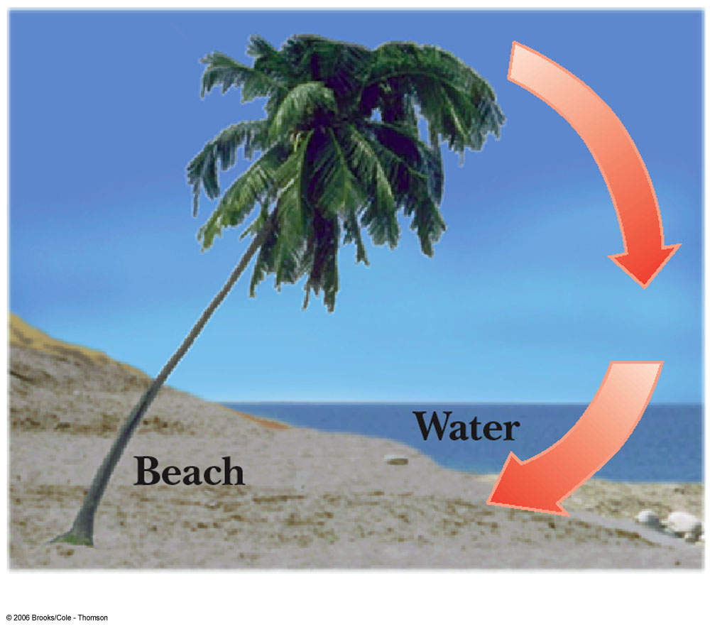
A Consequence of Different Specific Heats
Water has a high specific heat compared to land
On a hot day, the air above the land warms faster
The warmer air flows upward and cooler air moves toward the beach

Slide 61
Question 123.12.2
You add energy to an object by heat transfer. At some point, the temperature of the object stops rising. What is happening?
The system is leaking thermal energy
The system has as much heat as it can take
The object is experiencing a phase change
Can’t tell

Slide 62
Heating Ice
Gaseous steam
Boiling water
Liquid water
Melting ice
Solid ice

Slide 63
Graph of Ice to Steam
T(ºC)
150
120
90
60
30
0
-30
Steam
Water and Steam
Water
Ice and water
0 500 1000 1500 2000 2500 3000
Ice
Energy added (J)

Slide 64
20.3 Latent Heat

Slide 65
Phase Changes
A phase change occurs when the physical characteristics of the substance change from one form to another
Common phases changes are
Solid to liquid – melting
Liquid to gas – boiling
Phases changes involve a change in the internal energy, but no change in temperature

Slide 66
Latent Heat
During a phase change, the amount of heat is given as
Q = ±m L
L is the latent heat of the substance
Latent means hidden
L depends on the substance and the nature of the phase change
Choose a positive sign if you are adding energy to the system and a negative sign if energy is being removed from the system

Slide 67
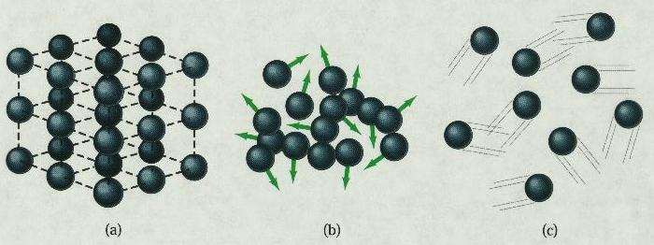
Phase Changes Latent Heat
Solid
Liquid
Gas
During a phase change, the internal energy changes but the temperature does not change.
Work is done against the attractive molecular forces to separate them.

Slide 68
Latent Heat, cont.
SI units of latent heat are J / kg
Latent heat of fusion, L_{f}, is used for melting or freezing
Latent heat of vaporization, L_{v}, is used for boiling or condensing
Table 11.2 gives the latent heats for various substances

Slide 69
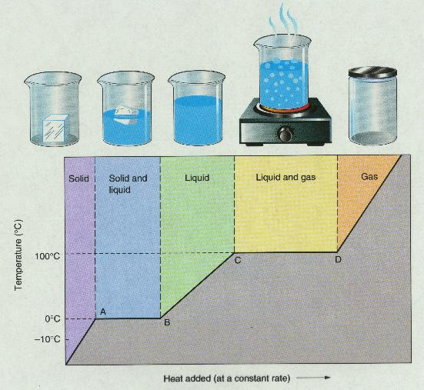
T vs. Q Graphs

Slide 71
Graph of Ice to Steam
T(ºC)
150
120
90
60
30
0
-30
Steam
Water and Steam
Water
Ice and water
0 500 1000 1500 2000 2500 3000
Ice
Energy added (J)

Slide 72
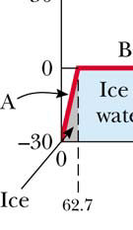
Warming Ice
Start with one gram of ice at –30.0º C
During A, the temperature of the ice changes from –30.0º C to 0º C
Use Q = m c ΔT
Will add 62.7 J of energy

Slide 73
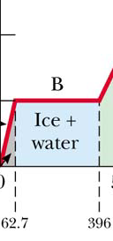
Melting Ice
Once at 0º C, the phase change (melting) starts
The temperature stays the same although energy is still being added
Use Q = m L_{f}
Needs 333 J of energy

Slide 74
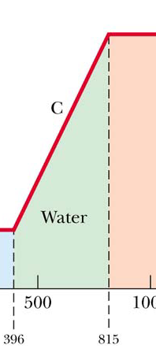
Warming Water
Between 0º C and 100º C, the material is liquid and no phase changes take place
Energy added increases the temperature
Use Q = m c ΔT
419 J of energy are added

Slide 75
Question 123.12.3
Will spaghetti cook faster if the water is boiling faster?
Yes
No
What is Spaghetti? I only eat Raman

Slide 76
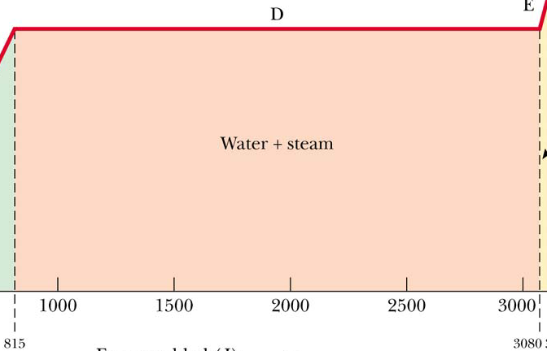
Boiling Water
At 100º C, a phase change occurs (boiling)
Temperature does not change
Use Q = m Lv
2 260 J of energy are needed

Slide 77
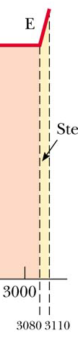
Heating Steam
After all the water is converted to steam, the steam will heat up
No phase change occurs
The added energy goes to increasing the temperature
Use Q = m c ΔT
To raise the temperature of the steam to 120°, 40.2 J of energy are needed

Slide 78
Question 123.12.4
You put 1 kg of ice at 0ºC together with 1 kg of water at 50ºC. What is the final temperature?
L_{F} = 3.33 x 10⁵ J/kg
c_{water} = 4190 J/(kg K)
a) 0ºC
b) between 0ºC and 50ºC
c) 50ºC
d) greater than 50ºC

Slide 79
Question 123.12.5
1 kg of water at 100 ºC is poured into a bucket that contains 4 kg of water at 0 ºC. Find the equilibrium temperature (neglect the influence of the bucket).
a) 0 ºC
b) 20 ºC
c) 50 ºC
d) 80 ºC
e) 100 ºC

Slide 80
Problem Solving Strategies
Make a table
A column for each quantity
A row for each phase and/or phase change
Use a final column for the combination of quantities
Use consistent units

Slide 81
Problem Solving Strategies, cont
Apply Conservation of Energy
Transfers in energy are given as Q=mcΔT for processes with no phase changes
Use Q = m L_{f} or Q = m L_{v} if there is a phase change
In Q_{cold} = - Q_{hot} be careful of sign
ΔT is T_{f} – T_{i}
Solve for the unknown

Slide 82
Calorimeter
One technique for determining the specific heat of a substance
A calorimeter is a vessel that is a good insulator which allows a thermal equilibrium to be achieved between substances without any energy loss to the environment

Slide 83
Calorimetry
Analysis performed using a calorimeter
Conservation of energy applies to the isolated system
The energy that leaves the warmer substance equals the energy that enters the water
Q_{cold} = -Q_{hot}
Negative sign keeps consistency in the sign convention of ΔT

Slide 84
Calorimeter
Sample at known temperature T_{x}
Water temperature rises
Water at known temperature T_{w}
Insulated container

Slide 85
Calorimetry
Object #1
Object #2

Slide 86
Calorimetry
Object #1
Object #2

Slide 87
Mixture Example
200 cm³ of hot water at 95ºC is poured into a 150 g glass cup initially at 25ºC. What is the final temperature of the mixture when equilibrium is reached, assuming no heat flows to the surroundings.

Slide 88
Mixture Example
200 g
What is the mass of 200 cm³ of water?

Slide 89
Calorimeter
Sample at known temperature T_{x}
Water temperature falls
Water at known temperature T_{w}
Insulated container

Slide 90
End

Slide 91
Question 123.8.11
What phase would this substance have if is were in the state represented by letter C?
Solid
Liquid
Gas
Plasma

Slide 95
Question 123.8.11
What phase would this substance have if is were in the state represented by letter A?
Solid
Liquid
Gas
Plasma

Slide 96
Question 123.8.11
What phase would this substance have if is were in the state represented by letter B?
Solid
Liquid
Gas
Plasma

Slide 97
Question 123.8.12
What is point D?
Sublimation point
Boiling point
Triple point
Double point
Critical point

Slide 98
Question 123.8.12
What is point E?
Sublimation point
Boiling point
Triple point
Double point
Critical point

Slide 99
Question 123.8.12
What do we call moving from region A to region B?
Boiling
Freezing
Melting
Condensing
Sublimation

Slide 100
Question 123.8.12
What do we call moving from region A to region C?
Boiling
Frezzing
Melting
Condensing
Sublimation

Slide 101
Question 123.8.12
What do we call moving from region B to region C?
Boiling
Frezzing
Melting
Condensing
Sublimation

Slide 102
Question 123.8.12
What do we call moving from region C to region B?
Boiling
Frezzing
Melting
Condensing
Sublimation

Slide 103
Question 123.8.12
What do we call moving from region B to region A?
Boiling
Frezzing
Melting
Condensing
Sublimation

Slide 104
Question 123.8.12
What phase is the material at if it is in the state represented by letter D?
Solid
Liquid
Gas
Plasma
Can’t tell

Slide 105
Question 123.8.12
What can we say about the state represented by point F?
Solid
Liquid
Gas
Plasma
It is a phase equilibrium

Slide 106
[Figure] [More Complete Phase Diagram for Water (Public Domain Image courtesy Karlhahn)]

Slide 107
Question 123.13.1
Why is C_{P} larger than C_{V}?
It has to do with the spacing of molecules
It is because no work is done in a isovolumetric process
It is because no work is done in an isobaric process
Can’t tell

Slide 108
Question 123.13.2
How does the internal energy of an ideal gas change as it follows the red path upward?
Increases
Decreases
Stays the same
Can’t tell

Slide 109
Question 123.13.2.1
How does the internal energy of an ideal gas change as it follows the green path from left to right?
Increases
Decreases
Stays the same
Can’t tell

Slide 110
Question 123.13.2.2
For which path, red or green, does the internal energy of an ideal gas change the most?
Red isochoric
Green isobaric
Both the same
Can’t tell

Slide 111

Δy
V
P
A

Slide 114
Question 123.13.3
For an adiabatic process PV^{γ} =….
A constant
nRT^{γ}
(nRT)^{γ}
Can’t tell

Slide 115
Question 123.13.4
Your home gets too cold in the winter. This is likely because you have too much
Convection
Conduction
Radiation
More than one of the above

Slide 116
Energy Transfer Mechanisms

Slide 117
Methods of Heat Transfer
Need to know the rate at which energy is transferred
Need to know the mechanisms responsible for the transfer
Methods include
Conduction
Convection
Radiation

Slide 118
Conduction
The transfer can be viewed on an atomic scale
It is an exchange of energy between microscopic particles by collisions
Less energetic particles gain energy during collisions with more energetic particles
Rate of conduction depends upon the characteristics of the substance

Slide 119
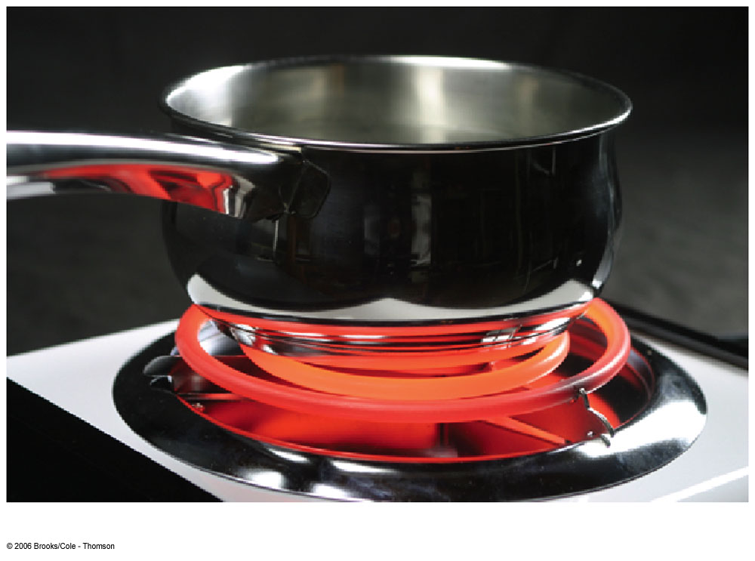
Conduction example
The molecules vibrate about their equilibrium positions
Particles near the stove coil vibrate with larger amplitudes
These collide with adjacent molecules and transfer some energy
Eventually, the energy travels entirely through the pan and its handle

Slide 120
Conduction, cont.
In general, metals are good conductors
They contain large numbers of electrons that are relatively free to move through the metal
They can transport energy from one region to another
Conduction can occur only if there is a difference in temperature between two parts of the conducting medium

Slide 121
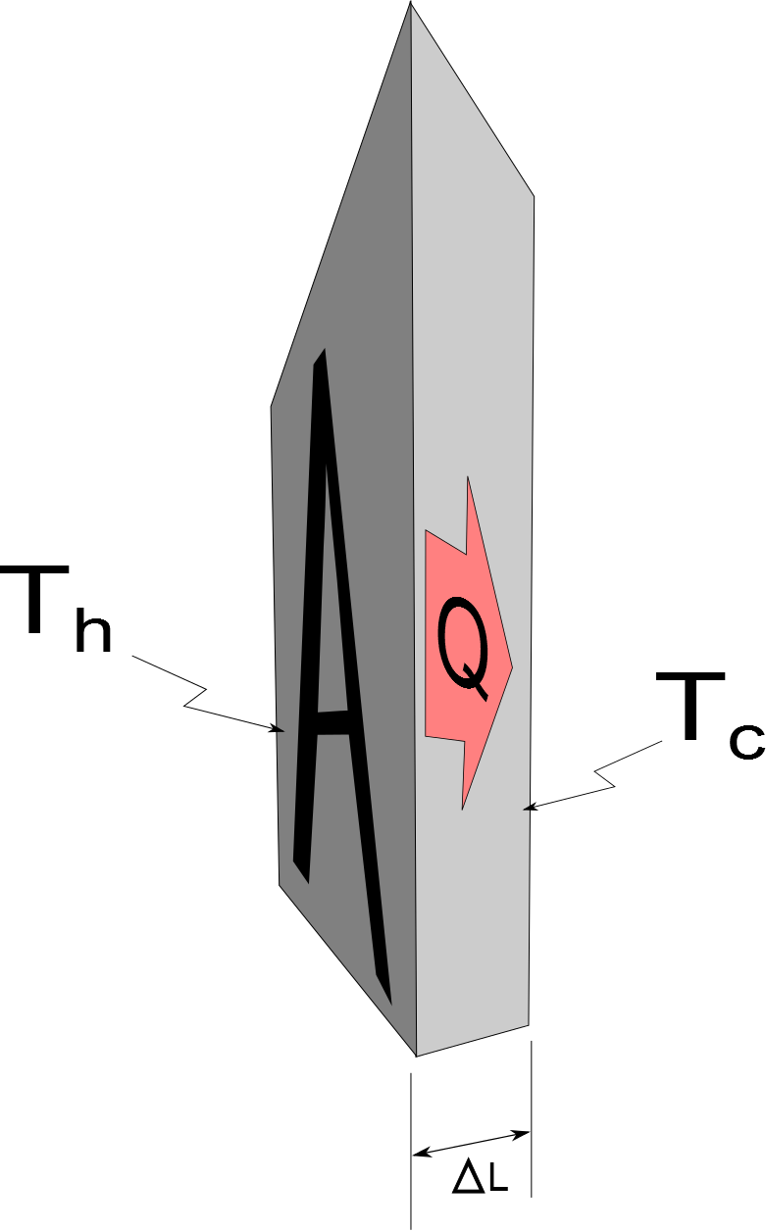
Conduction, equation
A
The slab allows energy to transfer from the region of higher temperature to the region of lower temperature

Slide 122
Conduction, equation explanation
A is the cross-sectional area
ΔL is the thickness of the slab or the length of a rod
P is in Watts when Q is in Joules and t is in seconds
k is the thermal conductivity of the material
See table 11.3 for some conductivities
Good conductors have high k values and good insulators have low k values

Slide 123
Home Insulation
Substances are rated by their R values
R = ΔL / k
See table 11.4 for some R values
For multiple layers, the total R value is the sum of the R values of each layer
Wind increases the energy loss by conduction in a home

Slide 124
Multiple Materials, cont.
The rate through the multiple materials will be
T_{H} and T_{C} are the temperatures at the outer extremities of the compound material

Slide 125
Convection
Energy transferred by the movement of a substance
When the movement results from differences in density, it is called natural conduction
When the movement is forced by a fan or a pump, it is called forced convection

Slide 126
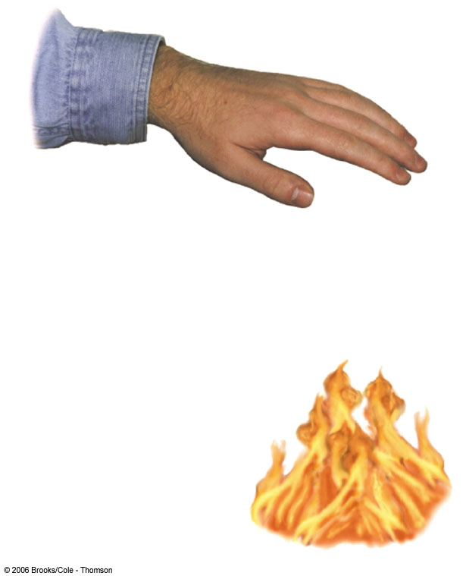
Convection example
Air directly above the flame is warmed and expands
The density of the air decreases, and it rises
The mass of air warms the hand as it moves by

Slide 127
Convection applications
Boiling water
Radiators
Upwelling
Cooling automobile engines
Algal blooms in ponds and lakes

Slide 128
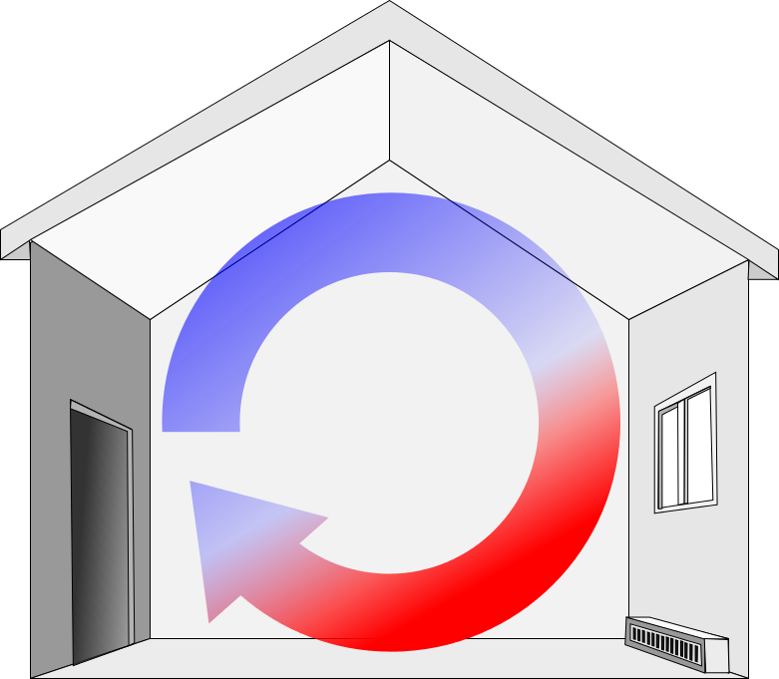
Convection Current Example
The radiator warms the air in the lower region of the room
The warm air is less dense, so it rises to the ceiling
The denser, cooler air sinks
A continuous air current pattern is set up as shown
Electric Base-Board Heater

Slide 129
Passive Convection Heating

Slide 130
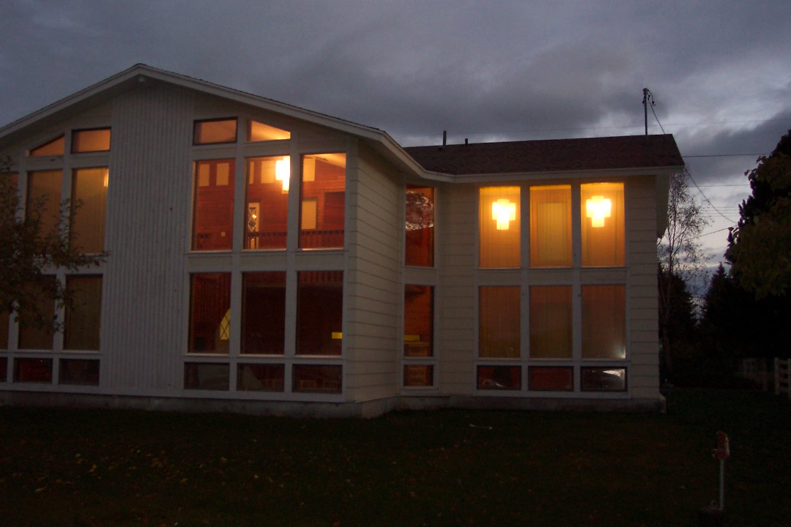
House Pictures

Slide 131

Upwelling

Slide 132
Radiation
Radiation does not require physical contact
All objects radiate energy continuously in the form of electromagnetic waves due to thermal vibrations of the molecules
Rate of radiation is given by Stefan’s Law

Slide 133
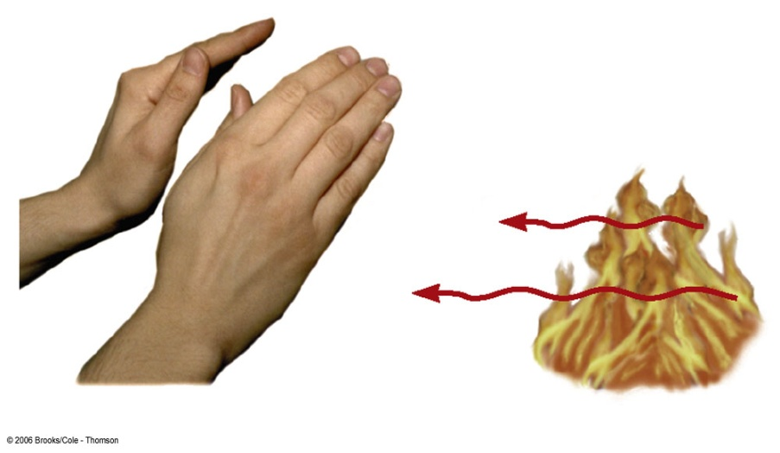
Radiation example
The electromagnetic waves carry the energy from the fire to the hands
No physical contact is necessary
Cannot be accounted for by conduction or convection

Slide 134
Radiation equation
The power is the rate of energy transfer, in Watts
σ = 5.6696 x 10⁻⁸ W/m^{2.}K⁴
A is the surface area of the object
e is a constant called the emissivity
e varies from 0 to 1
T is the temperature in Kelvins

Slide 135
Energy Absorption and Emission by Radiation
With its surroundings, the rate at which the object at temperature T with surroundings at T_{o} radiates is
When an object is in equilibrium with its surroundings, it radiates and absorbs at the same rate
Its temperature will not change

Slide 136
Ideal Absorbers
An ideal absorber is defined as an object that absorbs all of the energy incident on it
e = 1
This type of object is called a black body
An ideal absorber is also an ideal radiator of energy

Slide 137
Ideal Reflector
An ideal reflector absorbs none of the energy incident on it
e = 0

Slide 138
Applications of Radiation
Clothing
Black fabric acts as a good absorber
White fabric is a better reflector
Thermography
The amount of energy radiated by an object can be measured with a thermograph
Body temperature
Radiation thermometer measures the intensity of the infrared radiation from the eardrum

Slide 139
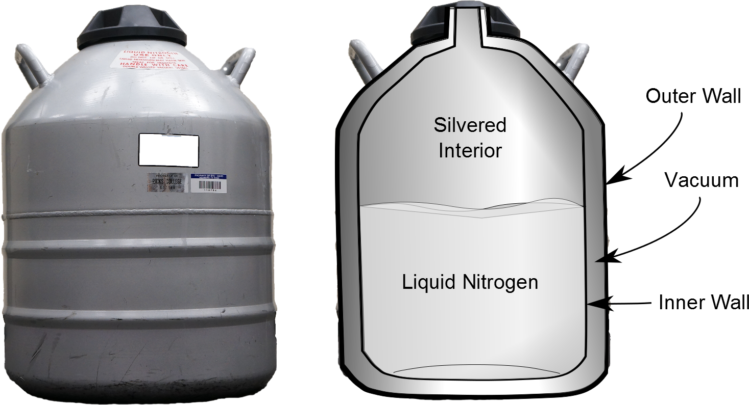
Resisting Energy Transfer
Dewar flask/thermos bottle
Designed to minimize energy transfer to surroundings
Space between walls is evacuated to minimize conduction and convection
Silvered surface minimizes radiation
Neck size is reduced

Slide 140
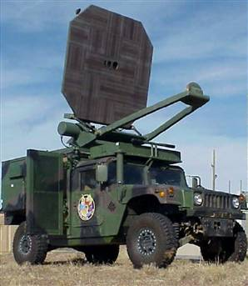
Radiation Example
Developed by the Air Force, the so-called "Active Denial System" (ADS) fires out milimeter waves -- a sort of cousin of microwaves, in the 95 GHz range. The invisible beams penetrate just a 64th of inch beneath the skin. But that's deep enough to heat up the water inside a person. Which is enough to cause excruciating pain.
http://www.defensetech.org/archives/002035.html

Slide 141
Global Warming
Greenhouse example
Visible light is absorbed and re-emitted as infrared radiation
Convection currents are inhibited by the glass
Earth’s atmosphere is also a good transmitter of visible light and a good absorber of infrared radiation
The Earth’s radiation budget (whether we have a positive or negative amount of energy transfer is hotly debated

Slide 142
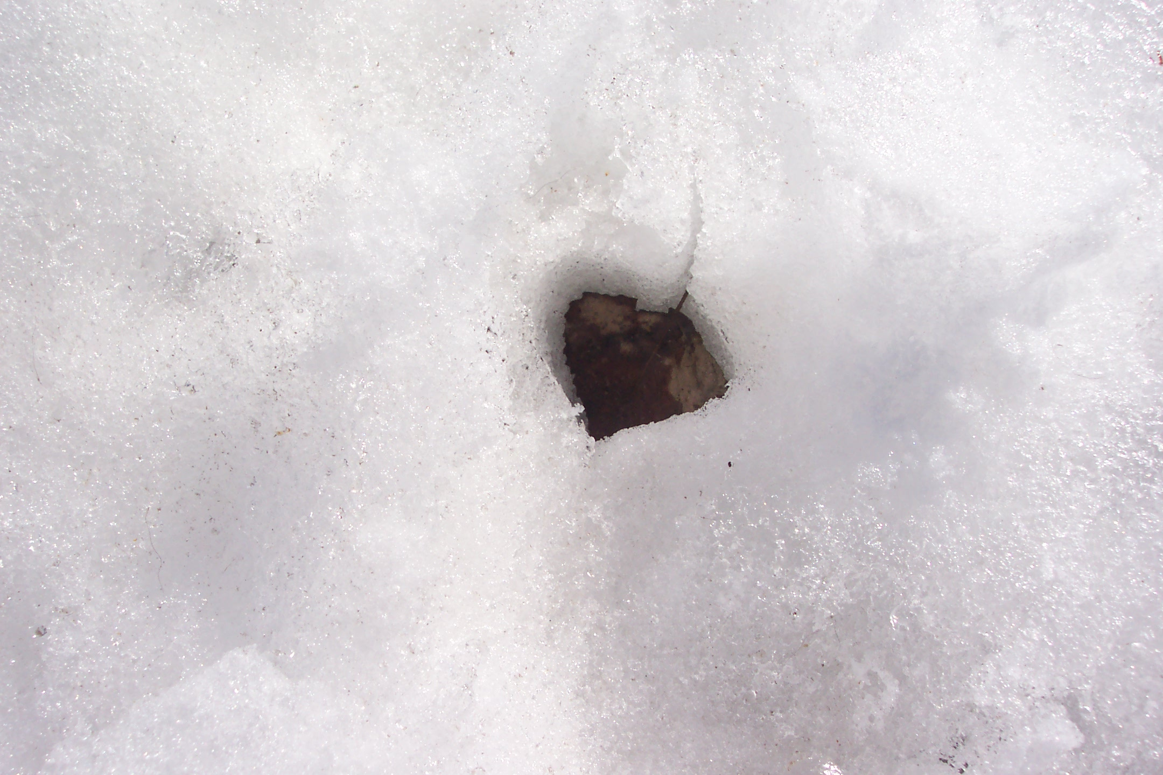
Question 123.13.5
You go outside on a cold spring morning in Rexburg. You see a leaf in the snow
The leaf seems to have sunk in the snow. What is the most likely reason for this?
The leaf is very massive so the force of gravity pulls it through the snow
The leaf has a different emissivity than the snow, so it absorbs more radiation from the sun, the temperature of the leaf rises and it melts the snow around it.
There was a very carful dog that stepped on the leaf, smashing it into the snow.

